Slide 1
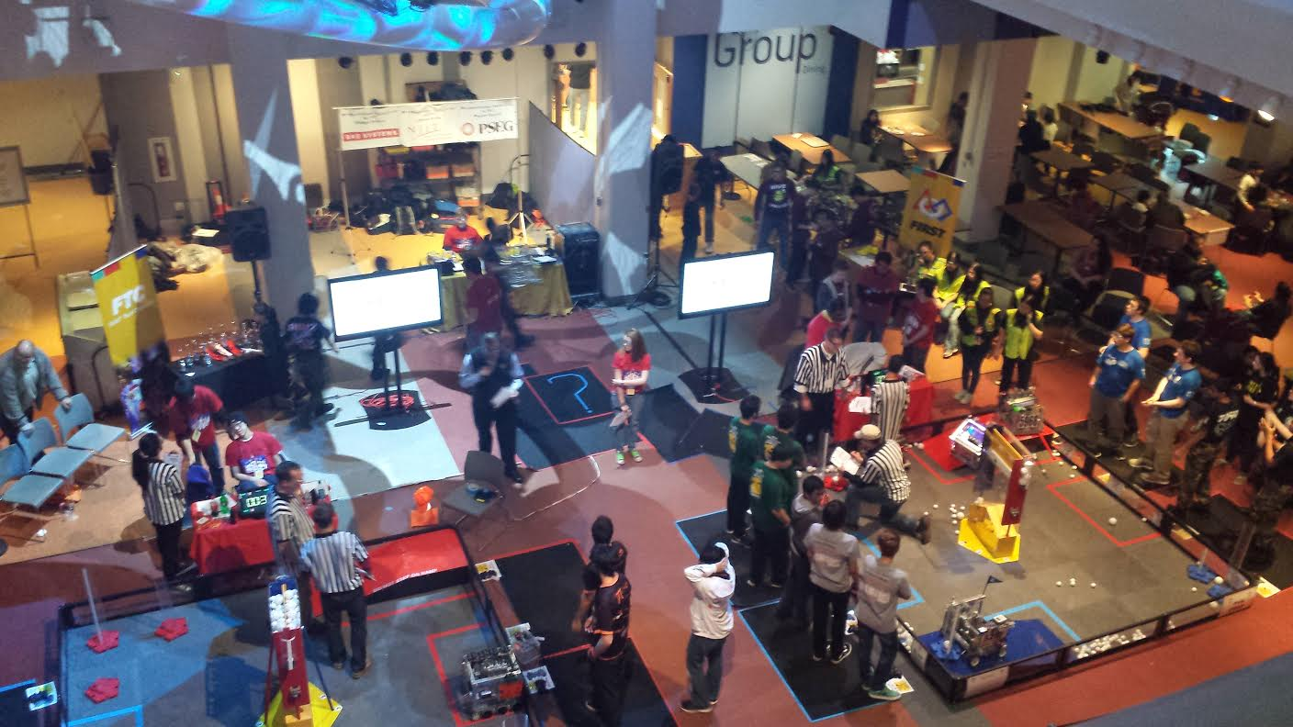
7350 Team Watt NXT, Edison New Jersey
Title
Page Number
On January 3rd, 2015, our team competed in a New Jersey Qualifier at Liberty Science Center. We used our newly made robot that included a carbon-fiber chasse, a not fully operational swerve-drive, and scissor lift that also was not entirely operational. We did emerge successful though, at the end of the Qualifier, due to strategic driving in tele-op and moving rolling goals onto our alliance's ramp.
Recorded by Sign Date
Time Start Stop

Slide 2
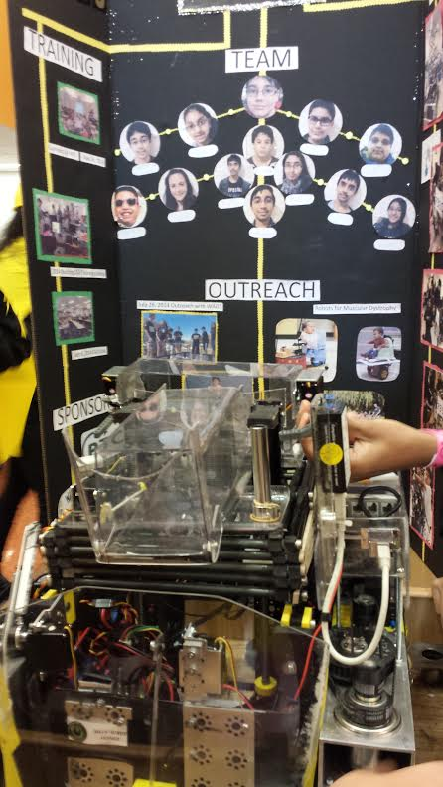
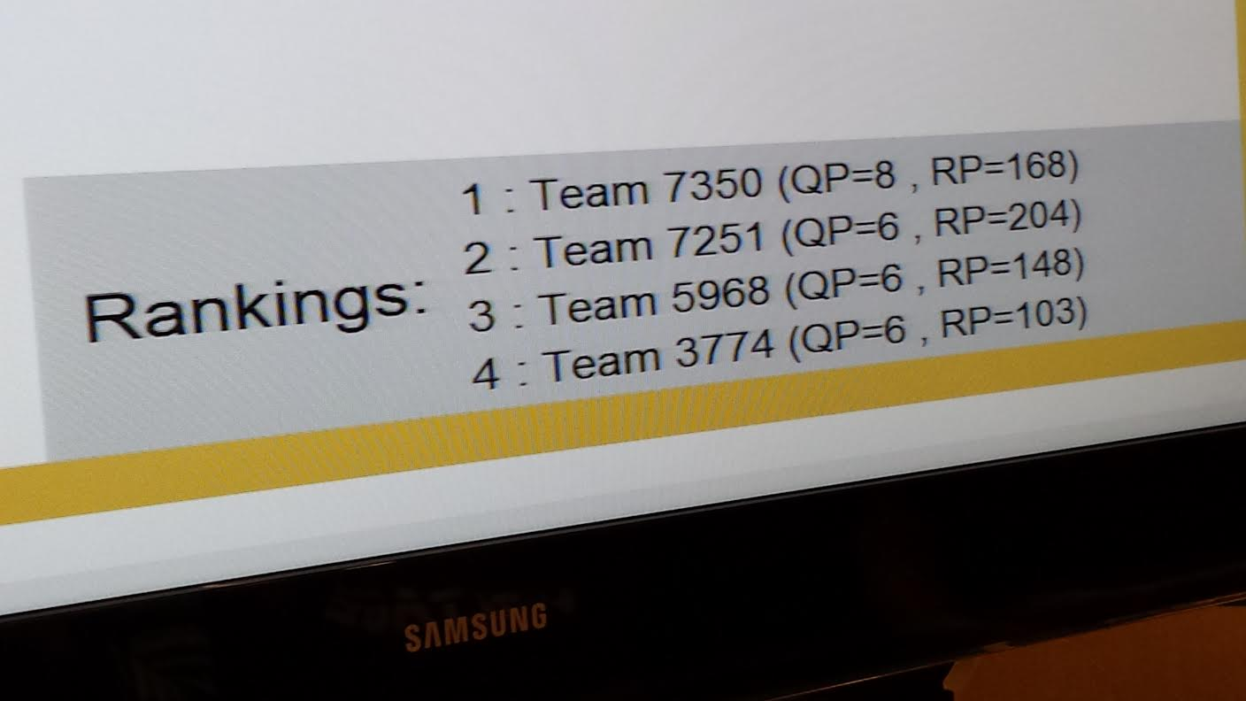
7350 Team Watt NXT, Edison New Jersey
Title
Page Number
What we decided we needed to work on after this Qualifier:
We have to add another motor to the scissor lift in order to give it enough power to raise up and down in order to score in all the rolling goals and the 120 cm. goal.
We have to change the servos in the swerve drive pods to MG’s so that they will be strong enough to hold the wheel in position, making our swerve drive mechanism possible.
We need to work on our tele-op and color sensor autonomous codes, as well as a swerve-drive code.
Recorded by Sign Date
Time Start Stop

